Slide 1

TakeItFree
Discover a world of free items tailored to your needs. Browse, select, and enjoy.

Slide 2
Purpose of the application
The purpose of the app is to make it easier for people to help each other by donating household items. The application has users with two roles - Booker and Uploader. Therefore, both users have independent functions such as uploading and reserving an item. The loader loads the item, which is automatically displayed on the booker's page. This makes it possible to contact and receive the item quickly and easily. In many developing countries, such as the Netherlands, items are left on the street for someone else to use. This application will make things easier for both the recipient and the sender.

Slide 3
Clarifying the users’ objectives
Basic Scenario
Registration/Login:
The user registers and logs into the application. If there are any errors (e.g., password strength or mismatched passwords), the system displays appropriate error messages.
Choosing Functionality:
The user chooses between uploading or booking an item from the main interface.
For Uploaders:
The user fills out the item information, including uploading photos.
The user must upload a photo to proceed; if not, they receive an error message.
For Bookers:
The user browses the listed items.
They add the desired item to their cart and confirm the booking.
They contact the uploader using the provided contact information.

Slide 4
Clarifying the users’ objectives
Advanced Scenario
Registration/Login:
Same as the basic scenario, but with additional validation checks and user guidance.
Choosing Functionality:
After logging in, users can seamlessly switch between uploading and booking items based on their role.
For Uploaders:
The user uploads multiple items.
They receive notifications or feedback if there are issues with their submissions.
For Bookers:
They view detailed item descriptions and may interact with multiple uploaders.
The system tracks their bookings and provides status updates.

Slide 5
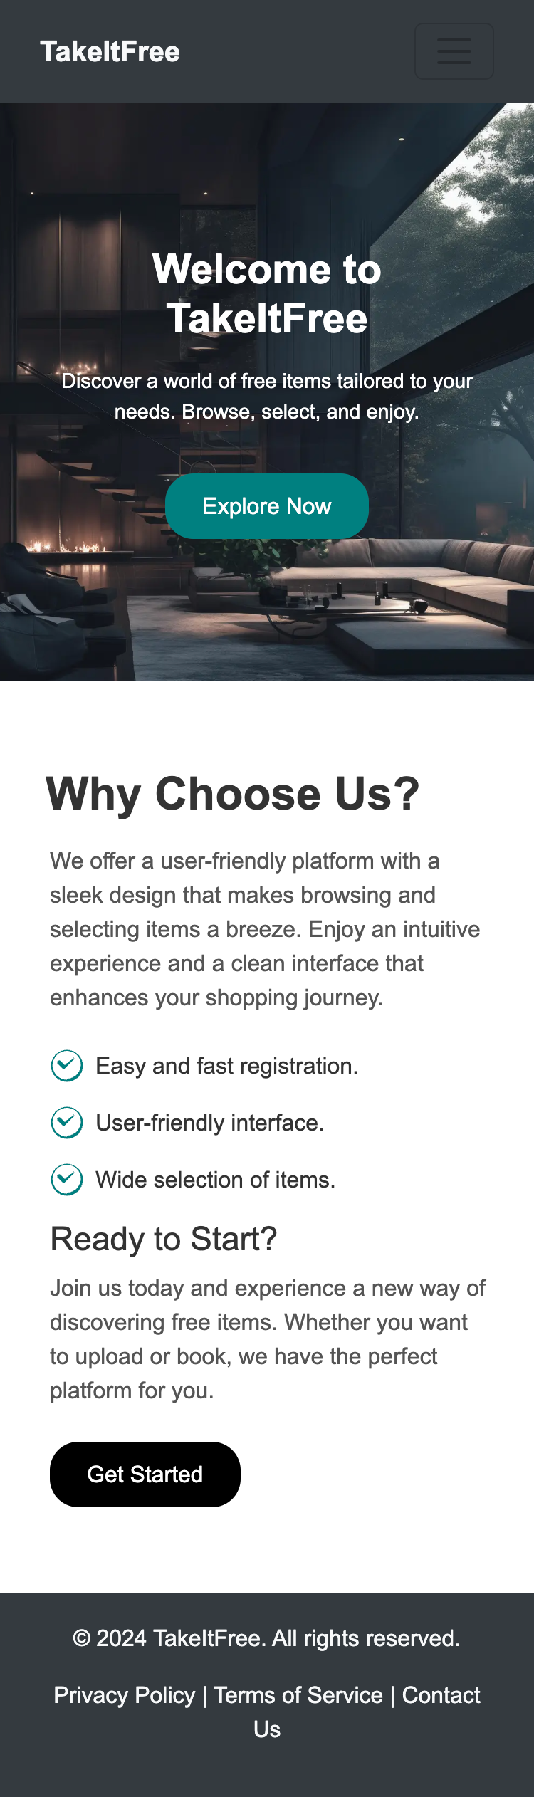
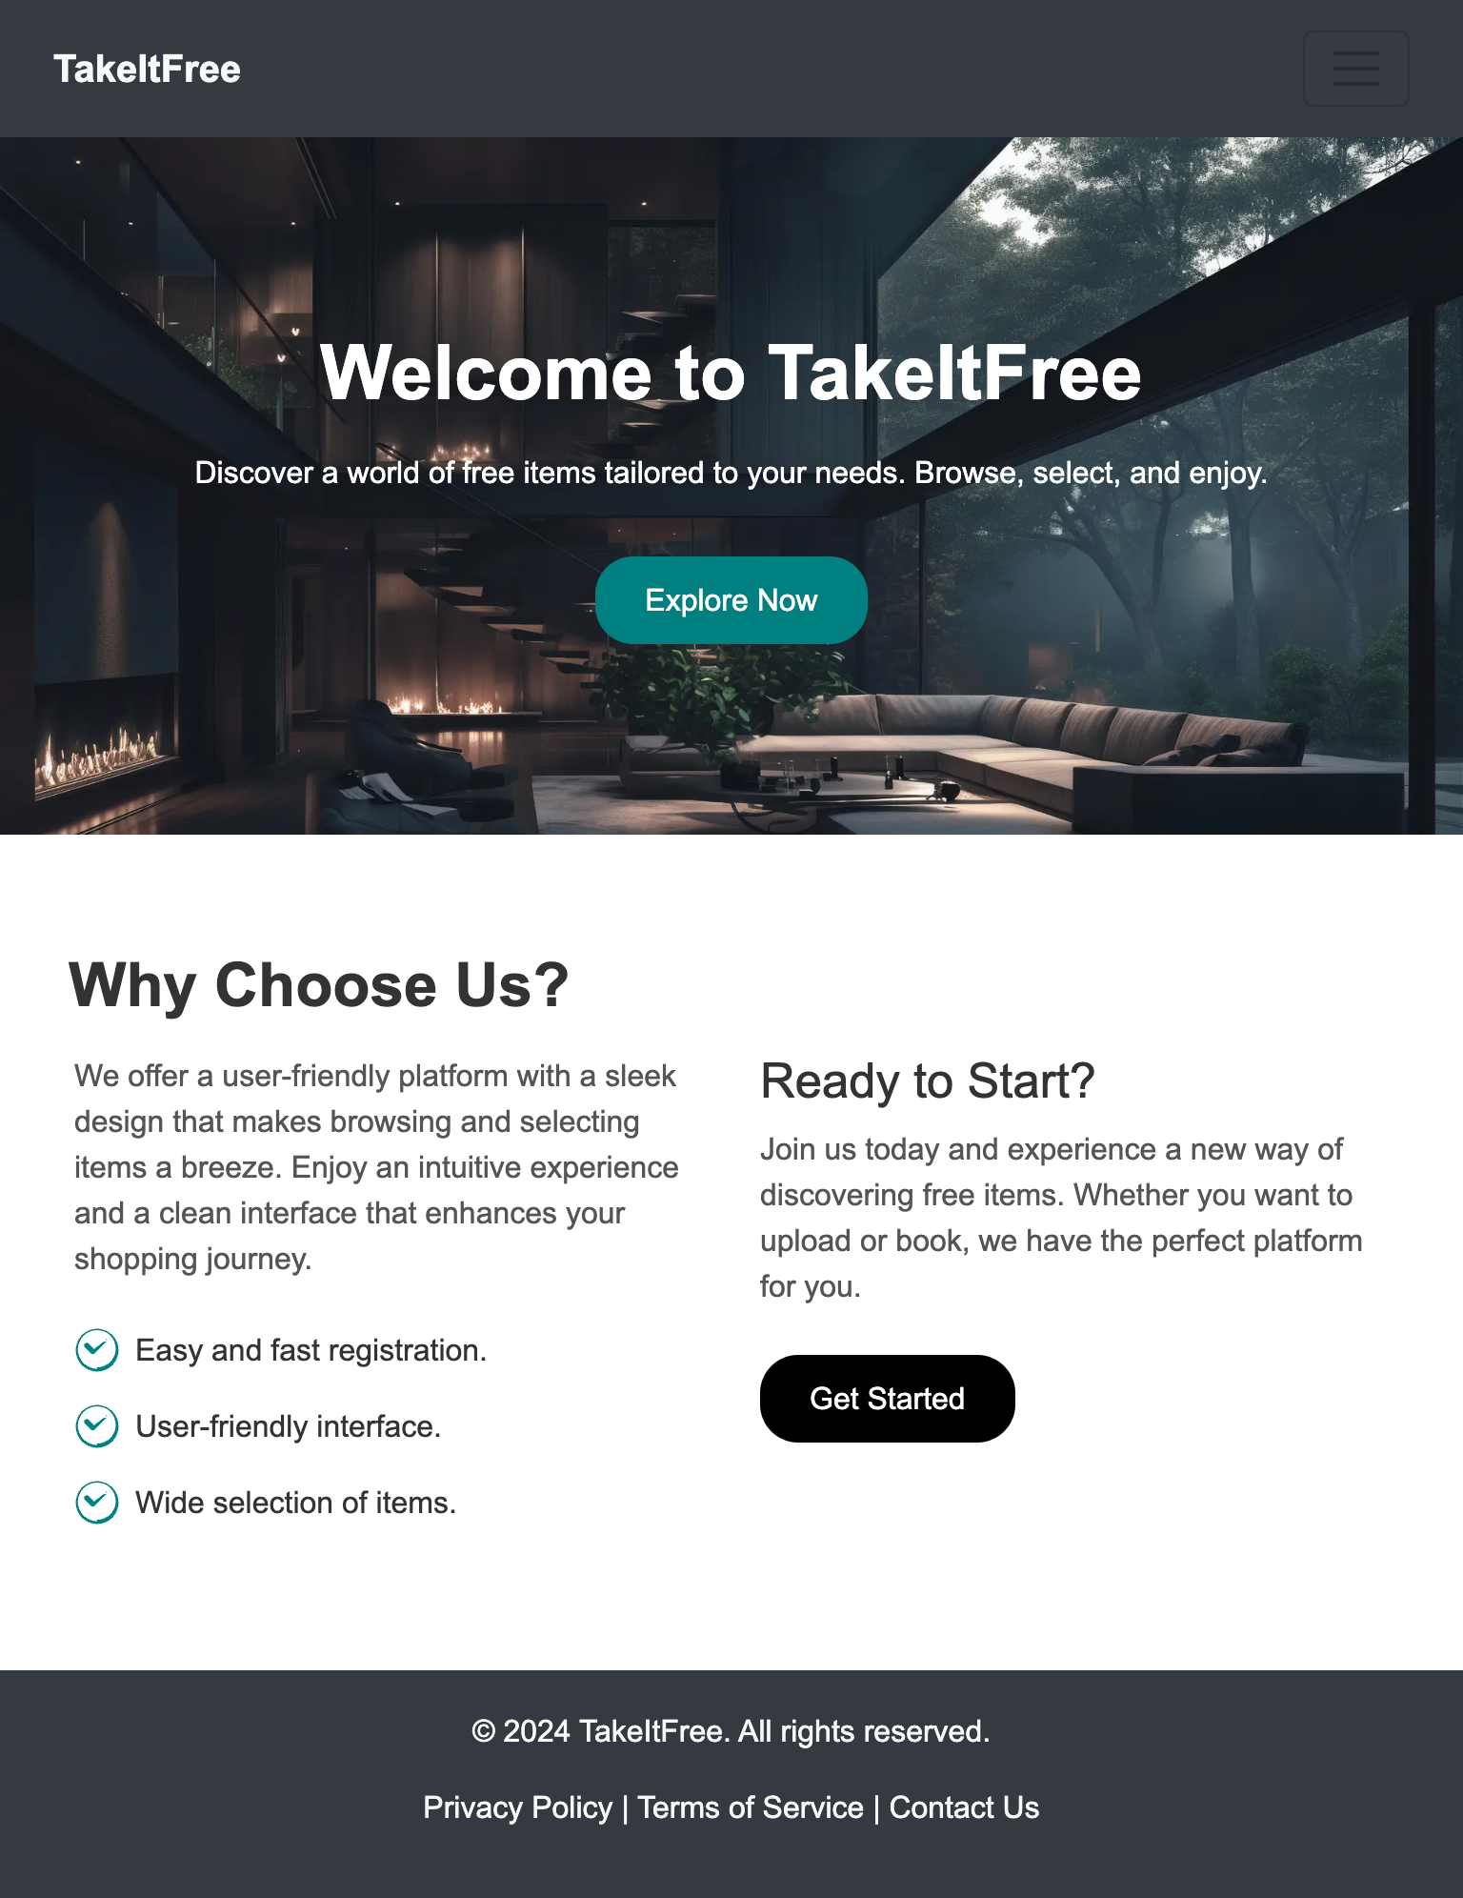
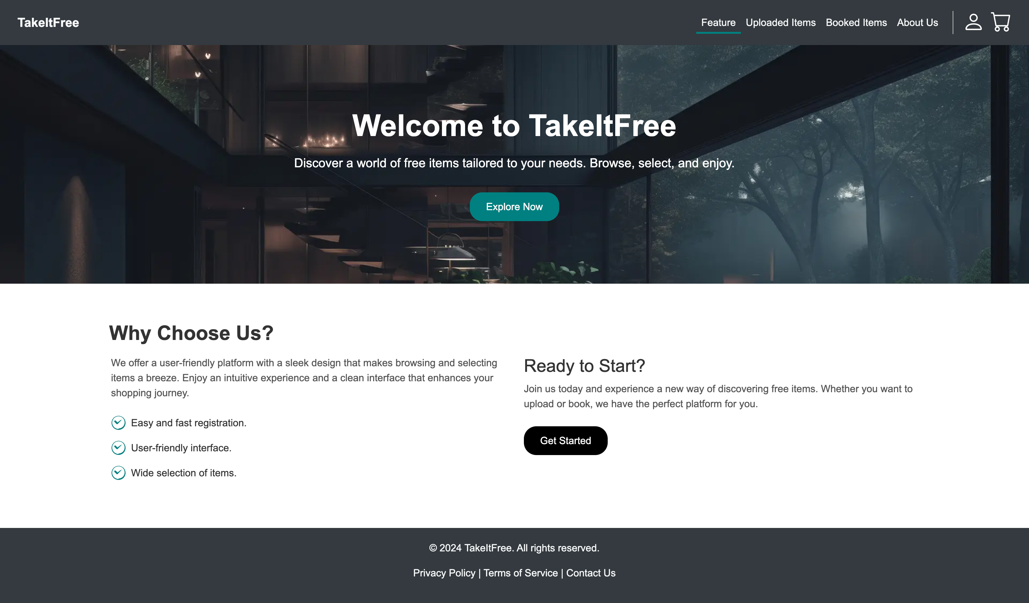
Capstone Project Interface Design
Compatible with Desktop, Tablet, Mobile Resolutions.

Slide 6

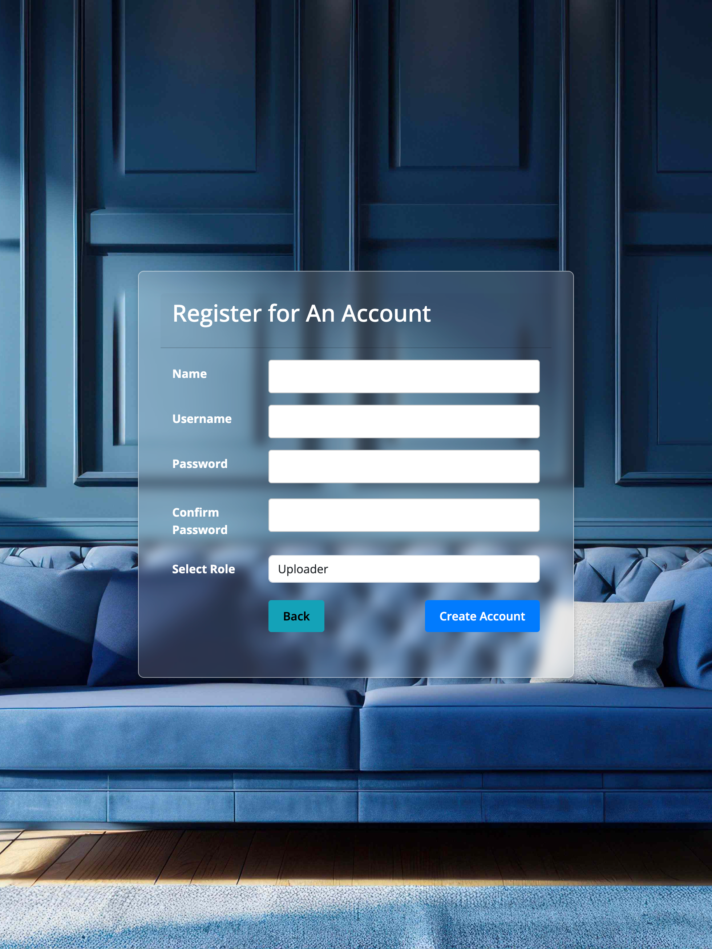
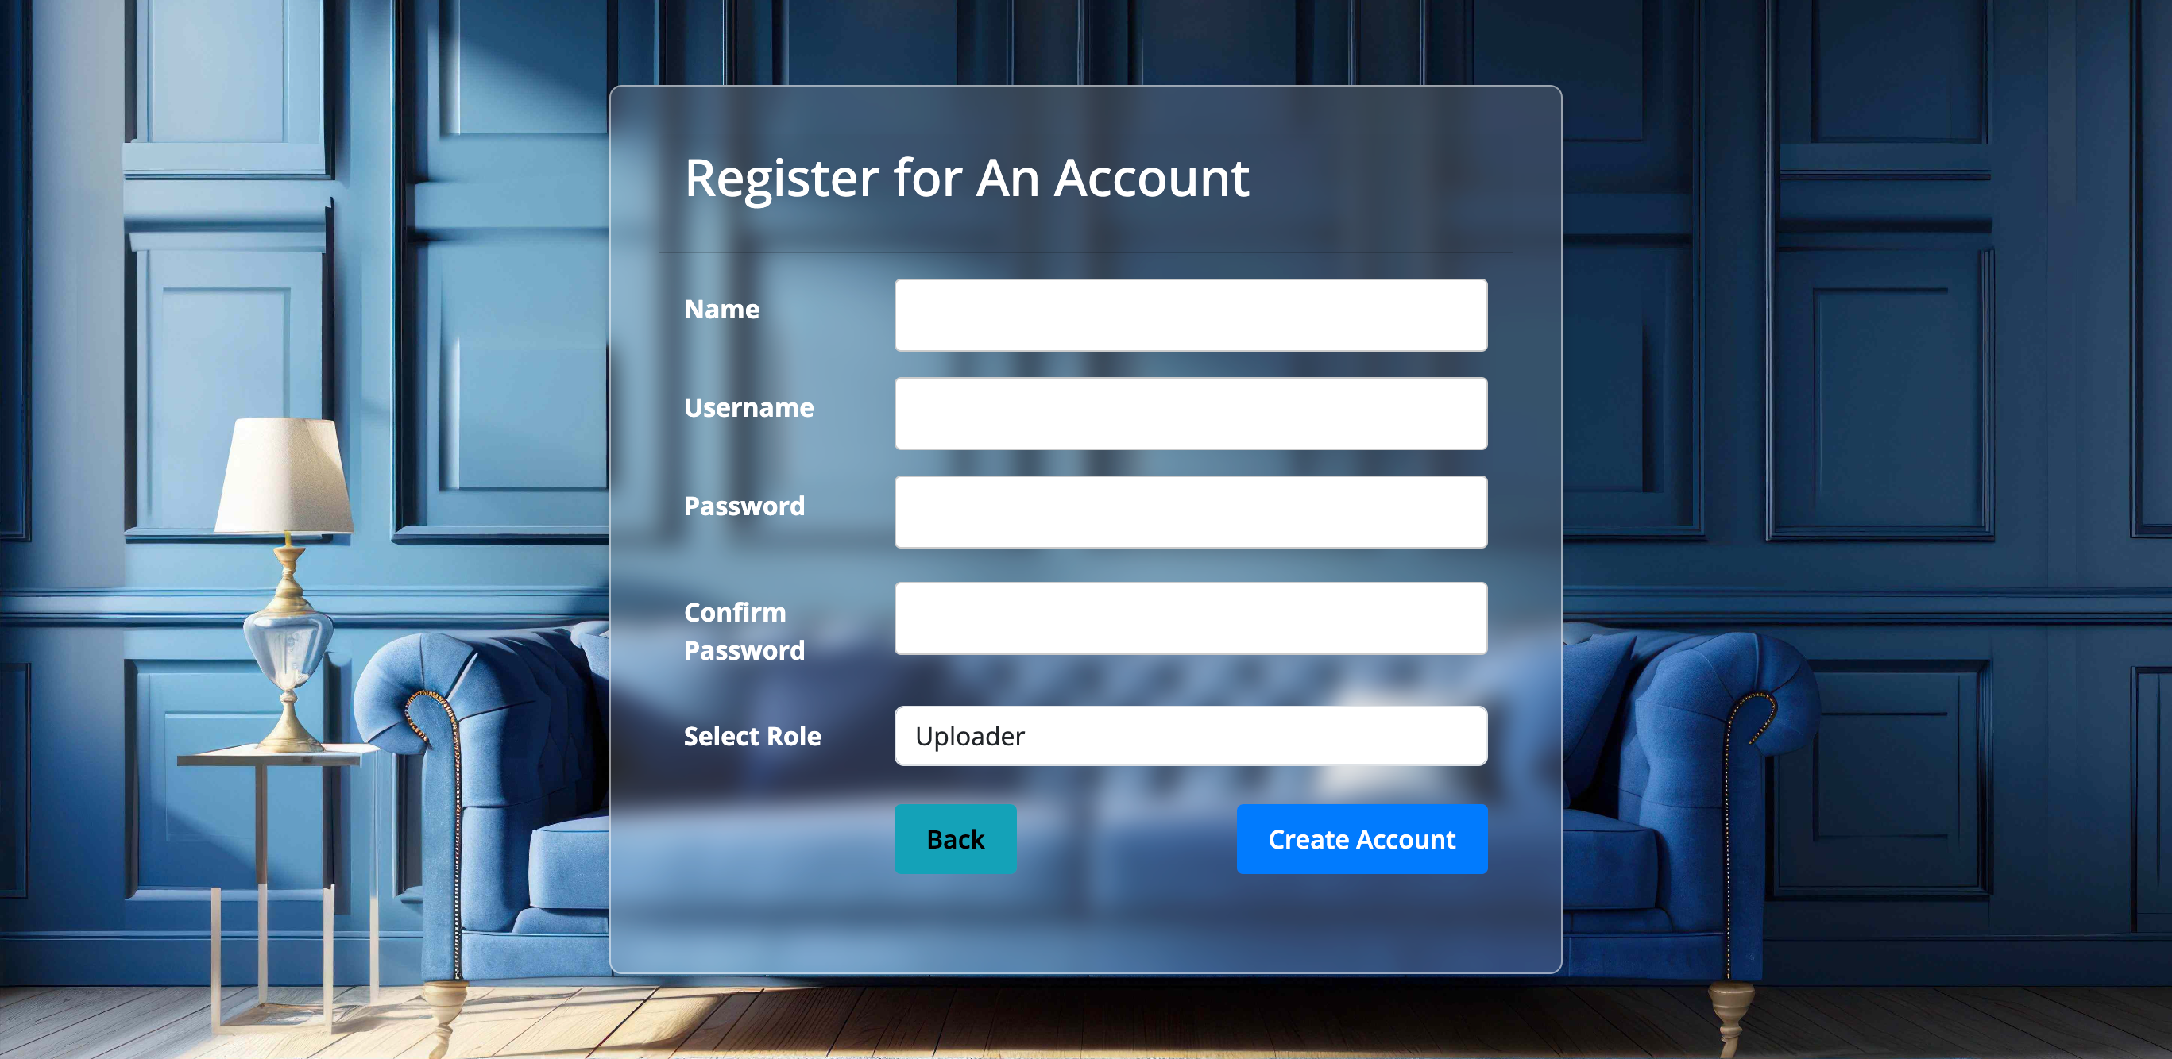
Capstone Project Interface Design
Compatible with Desktop, Tablet, Mobile Resolutions.

Slide 7

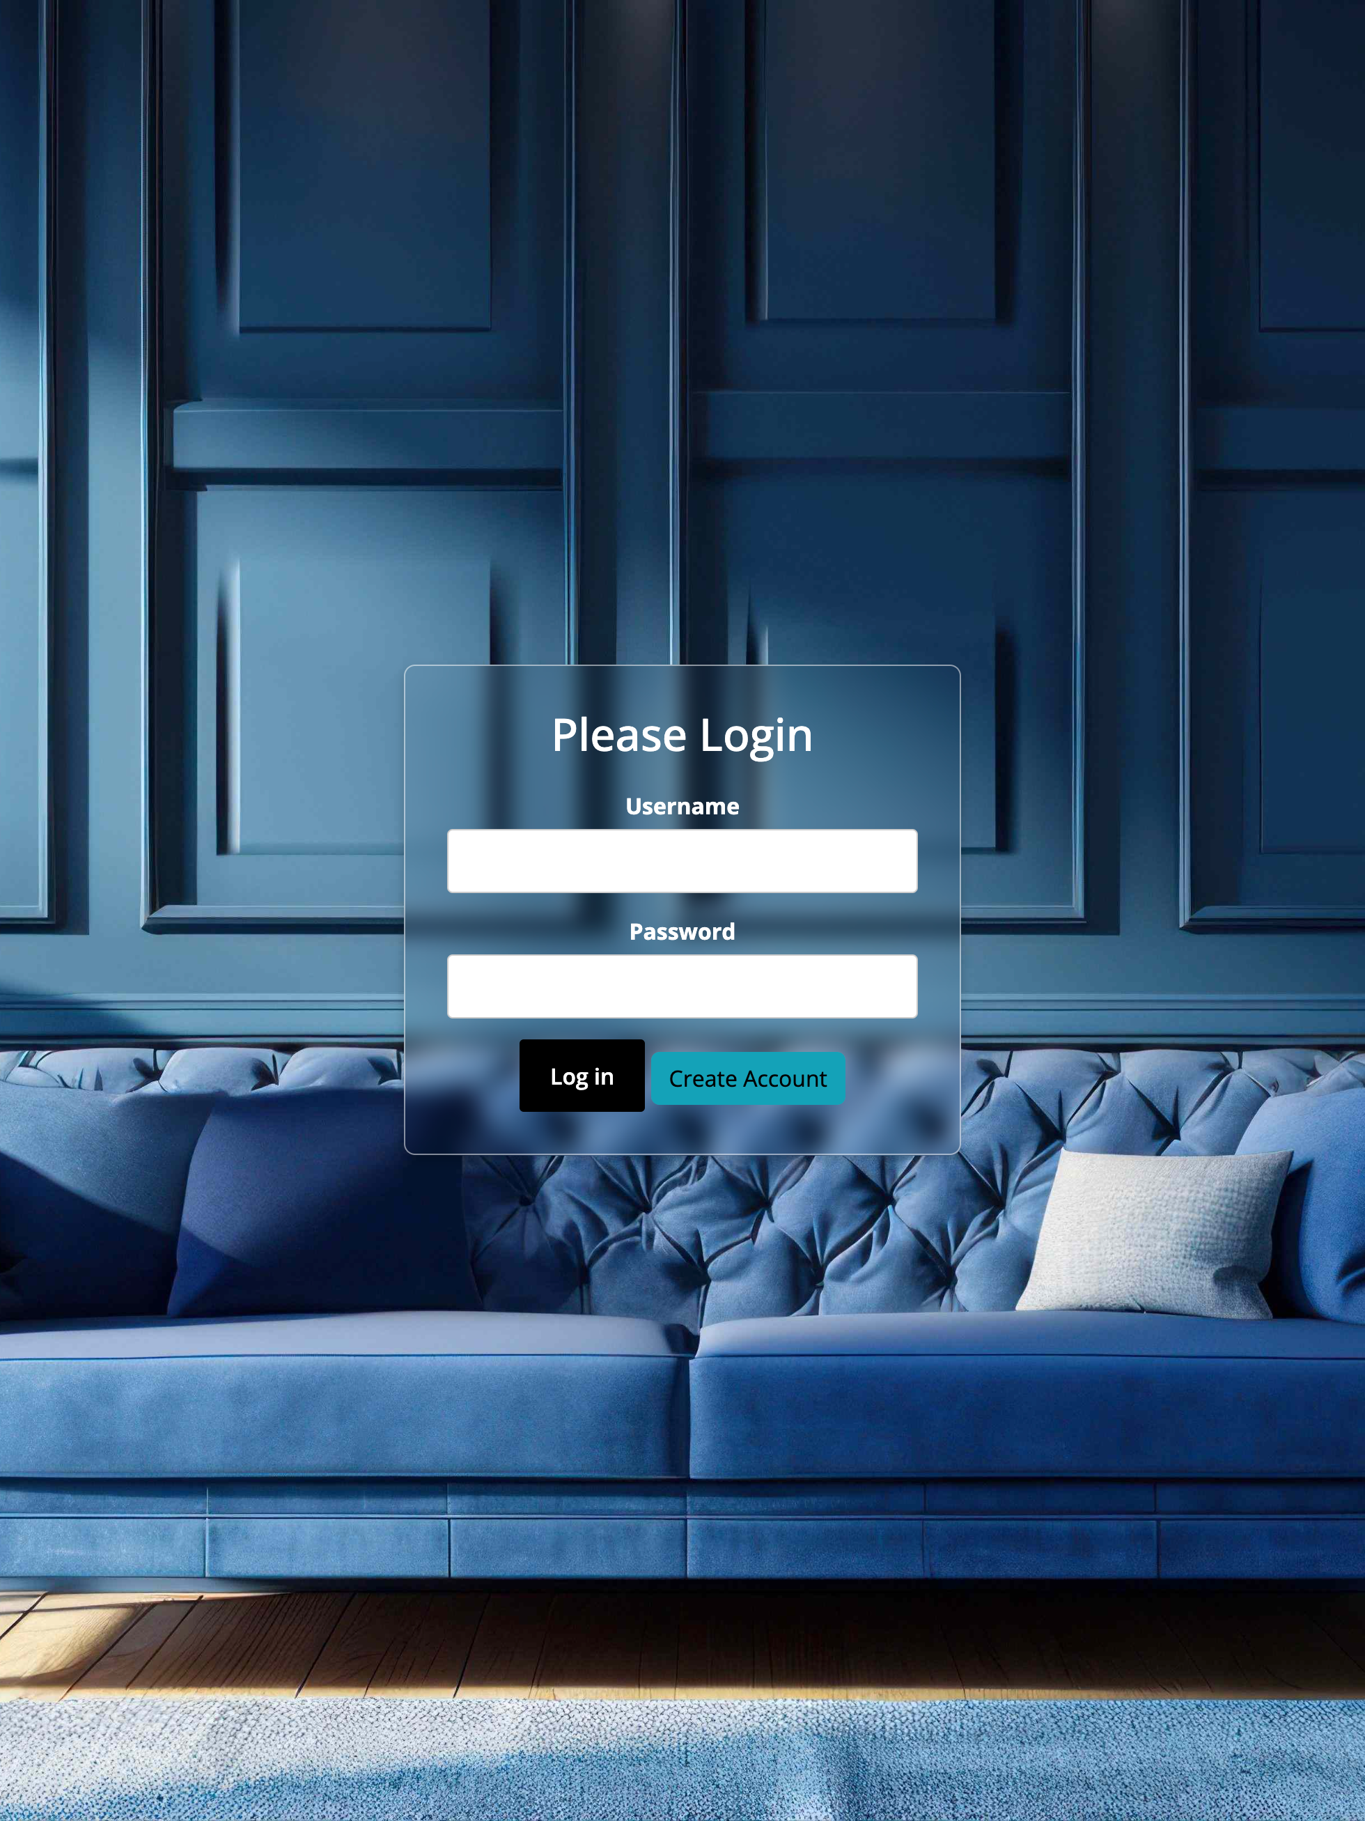
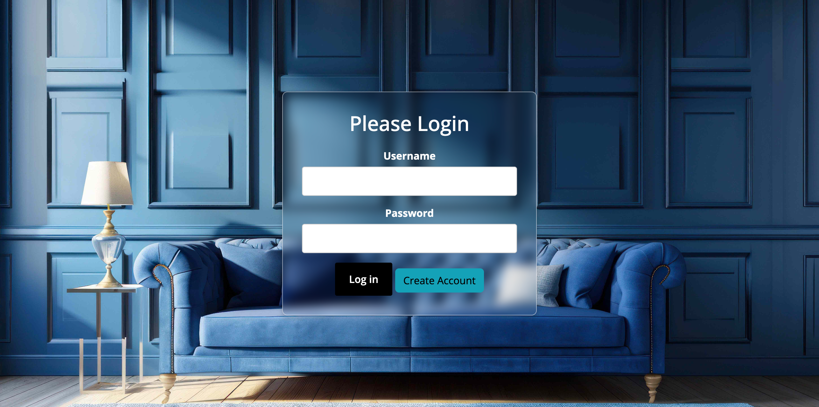
Capstone Project Interface Design
Compatible with Desktop, Tablet, Mobile Resolutions.

Slide 8
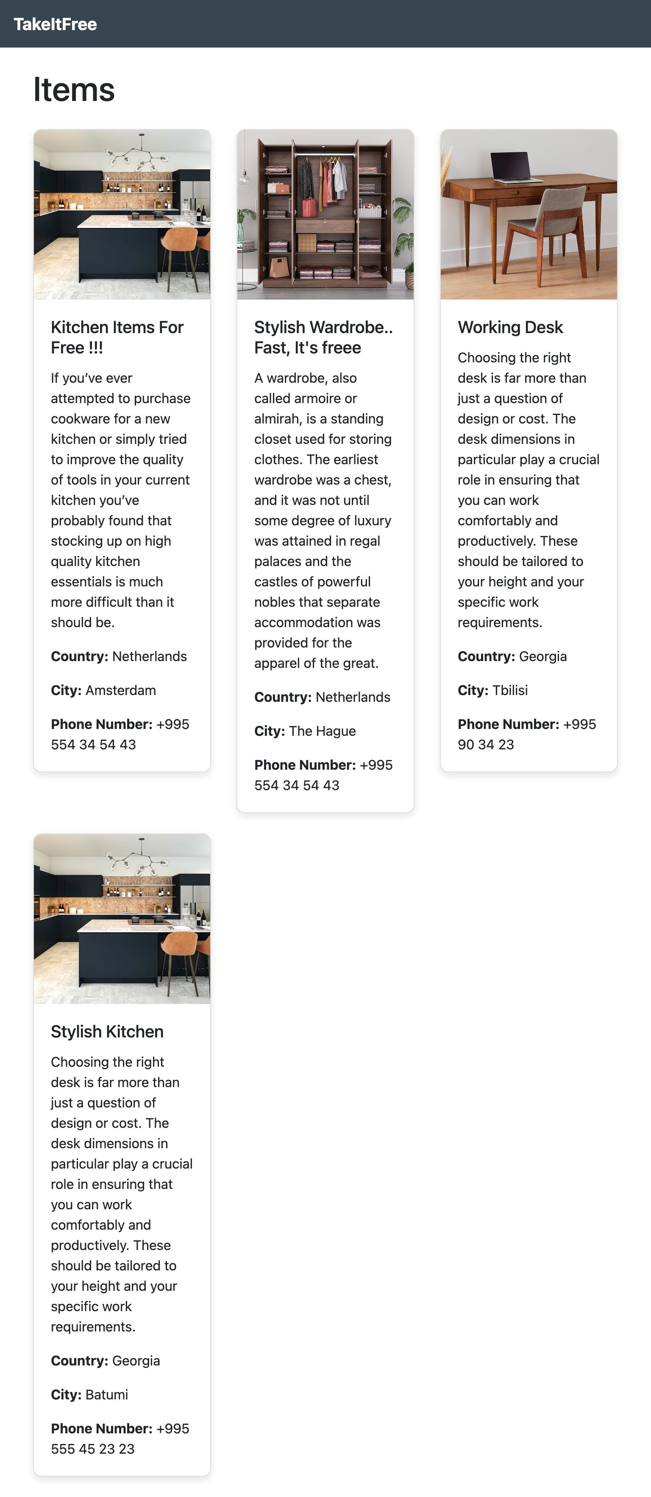
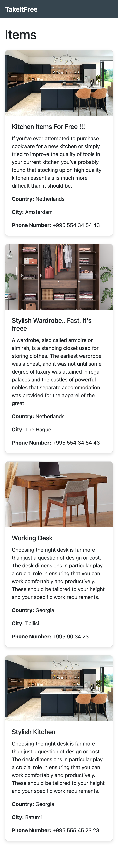
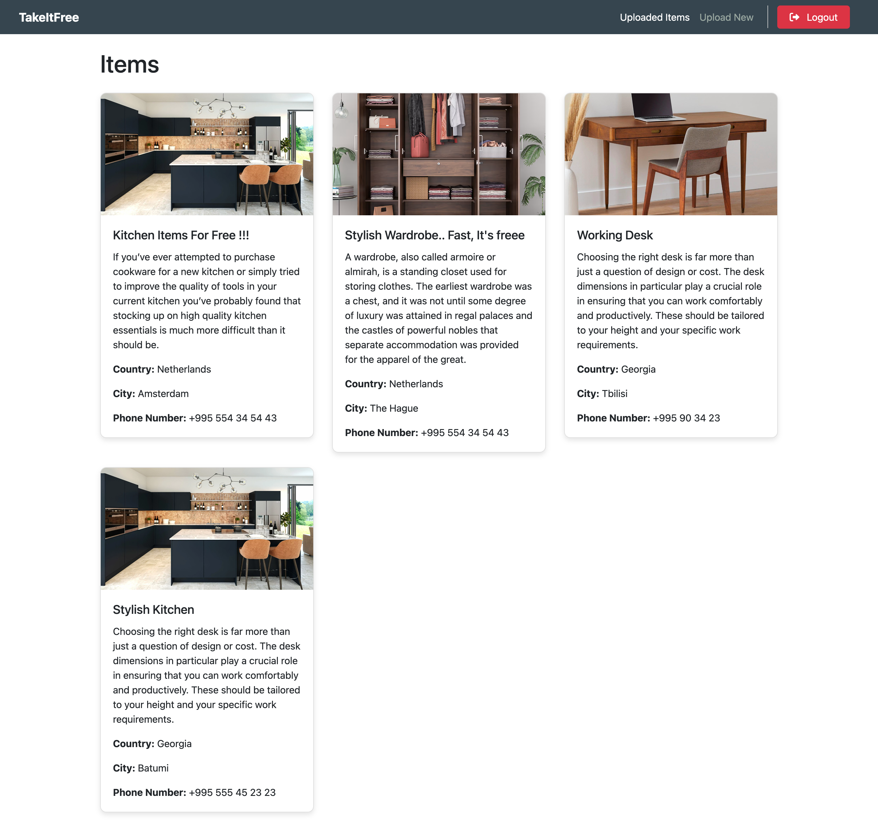
Capstone Project Interface Design
Compatible with Desktop, Tablet, Mobile Resolutions.

Slide 9
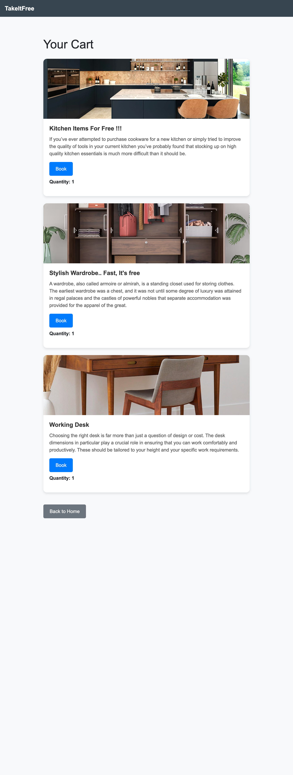
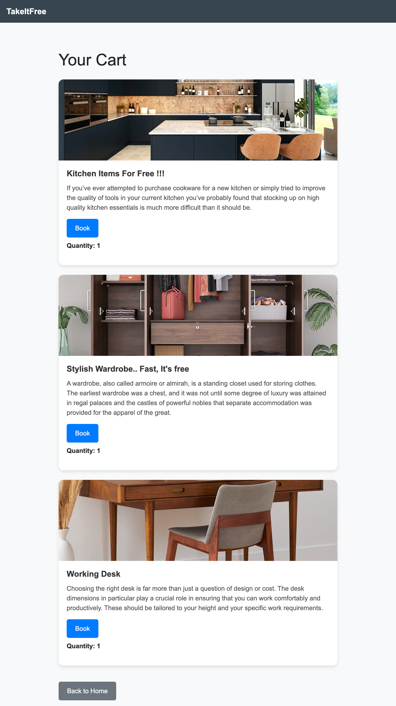
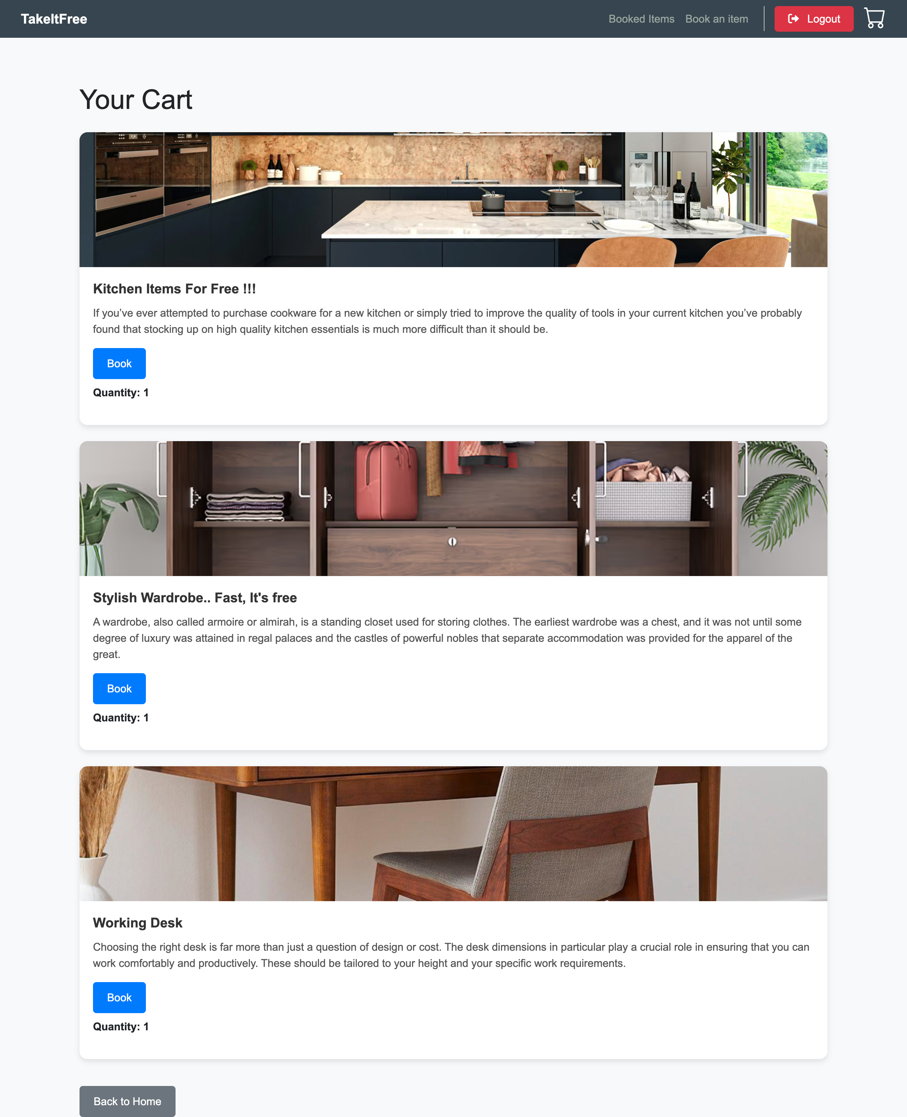
Capstone Project Interface Design
Compatible with Desktop, Tablet, Mobile Resolutions.

Slide 10
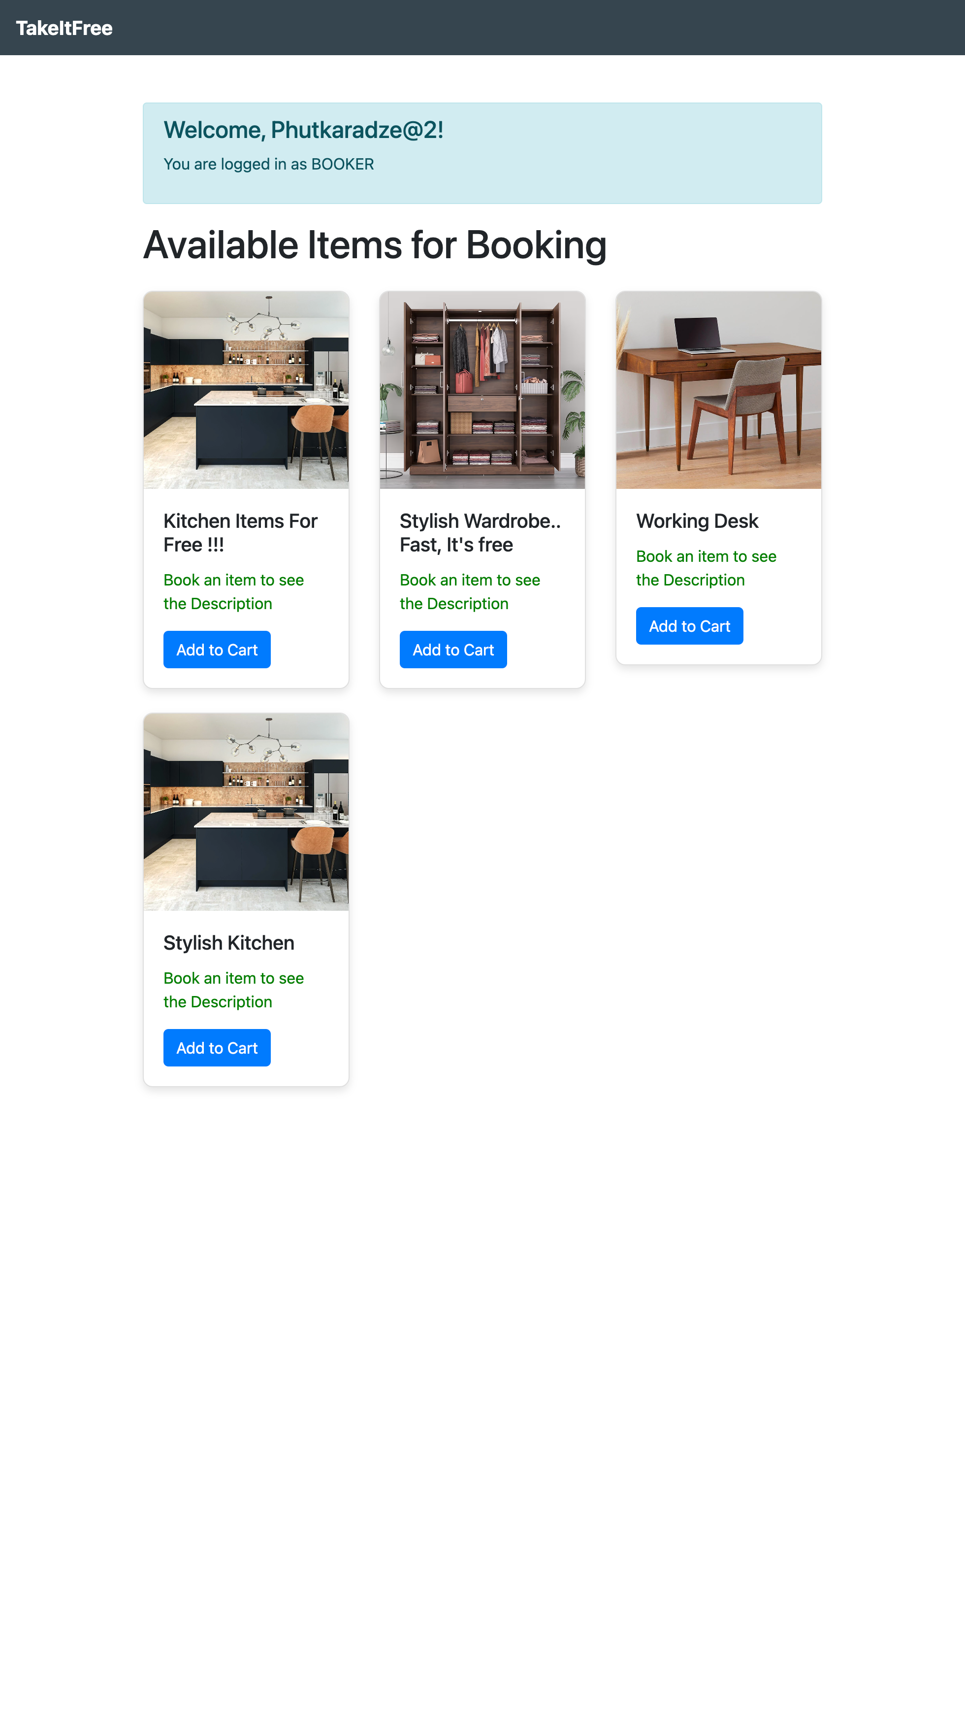
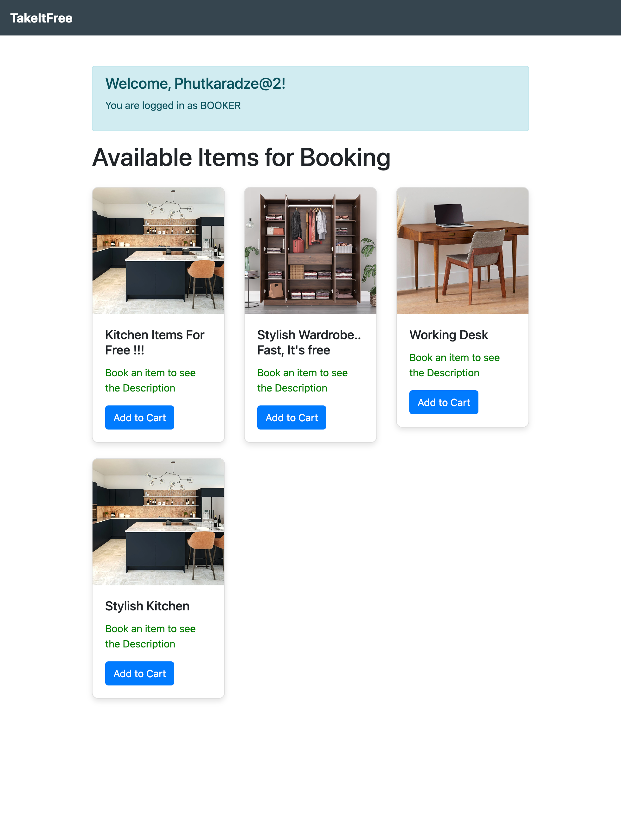
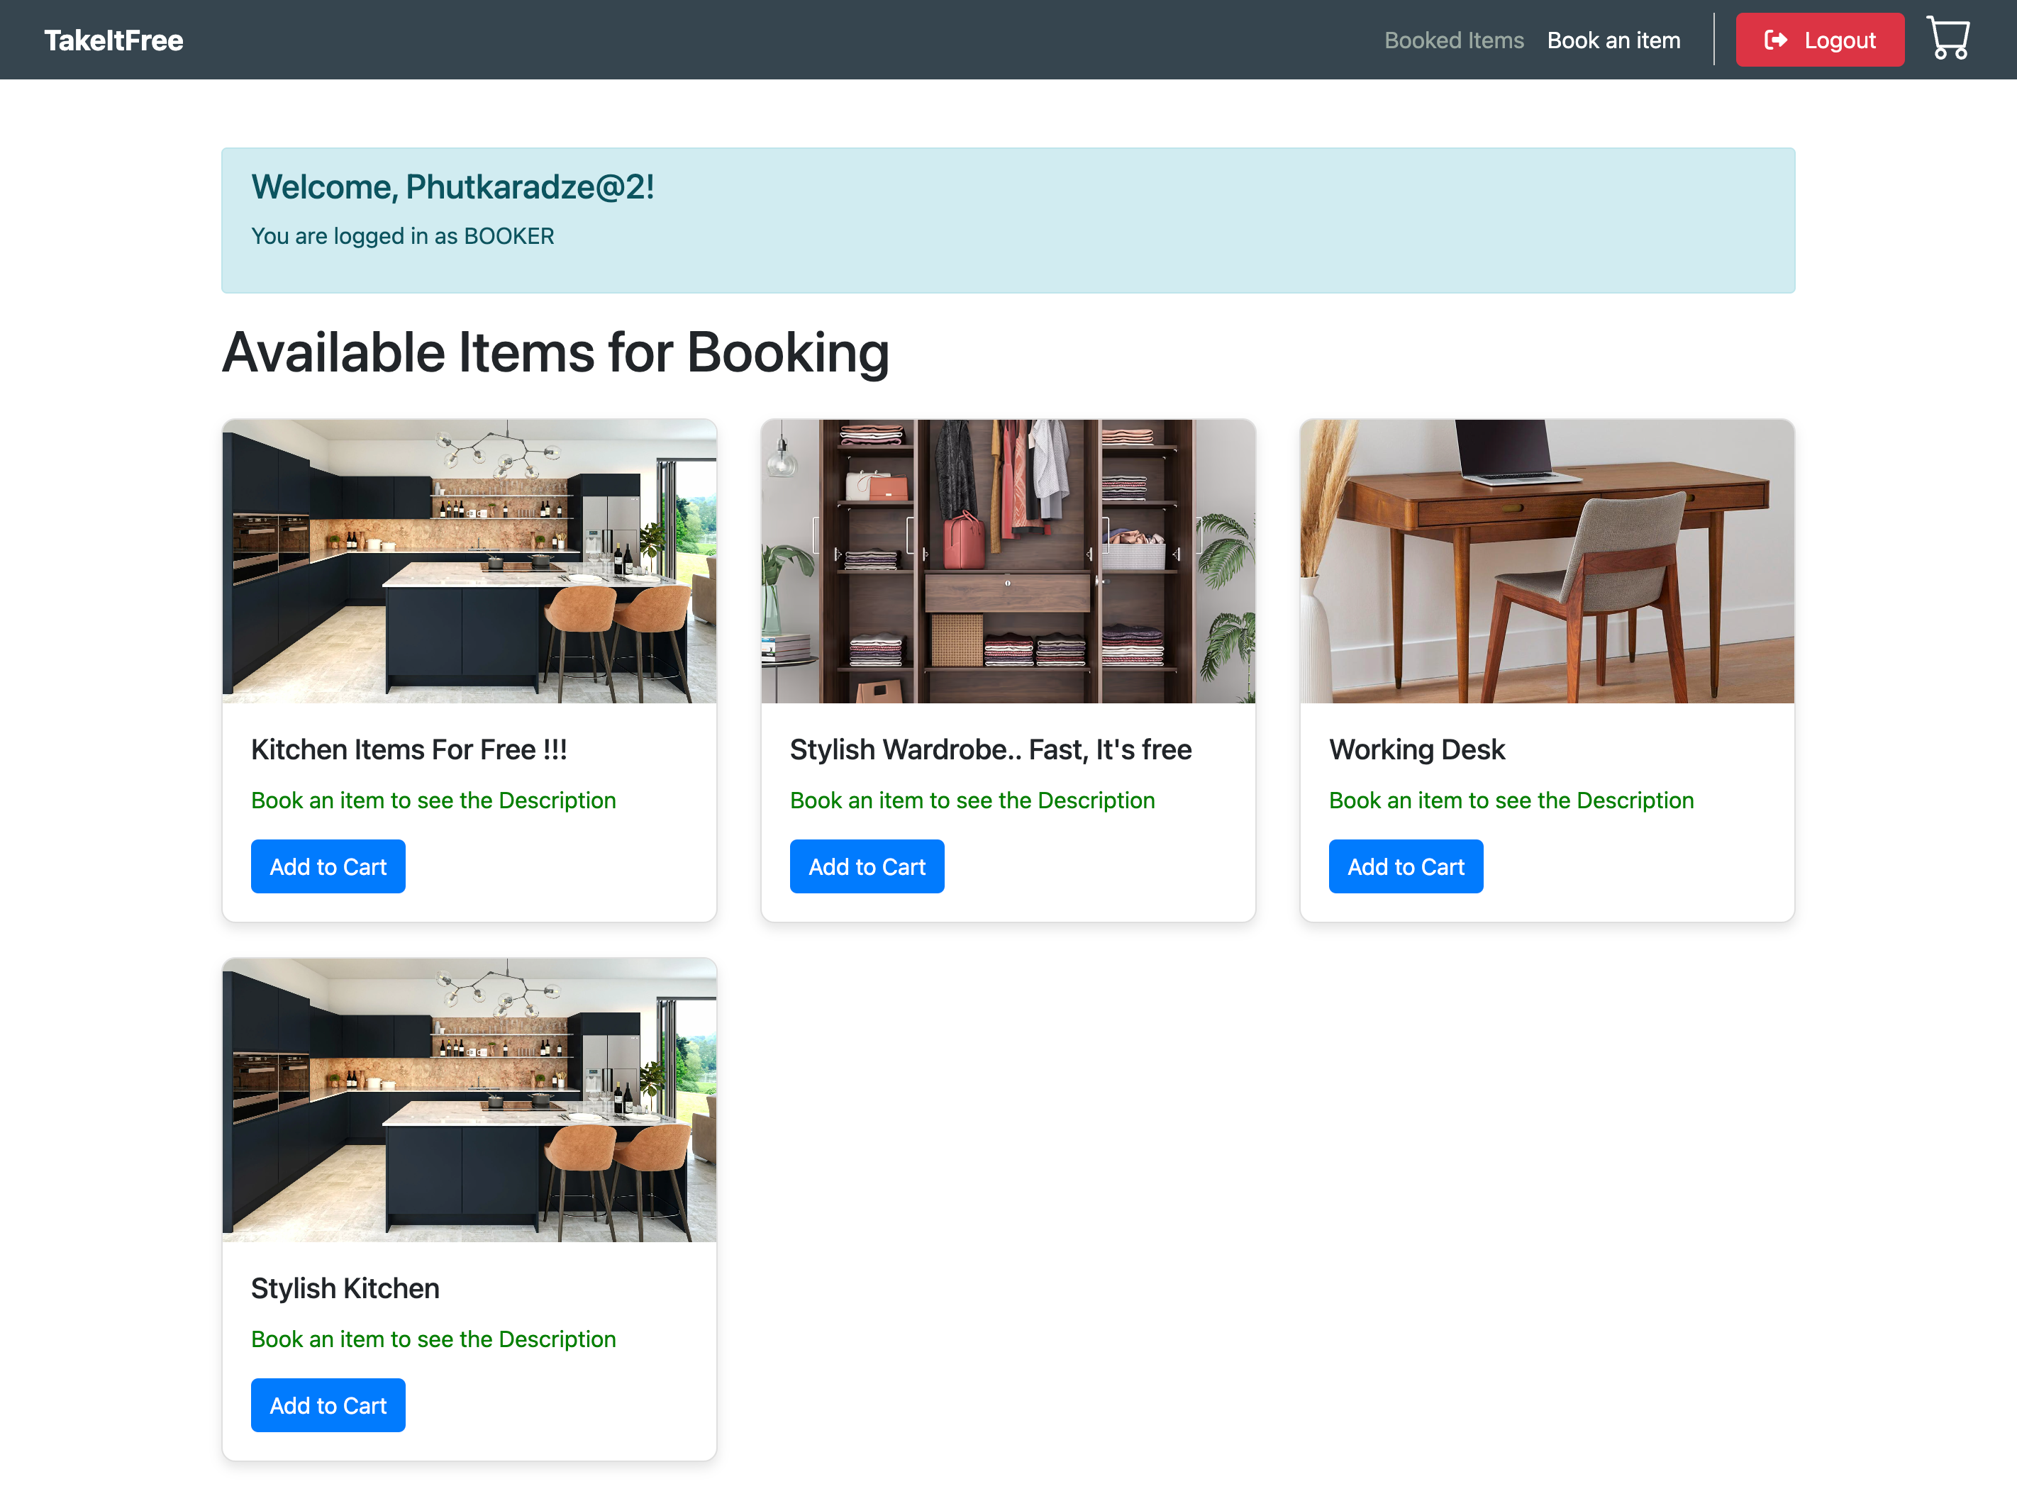
Capstone Project Interface Design
Compatible with Desktop, Tablet, Mobile Resolutions.

Slide 11
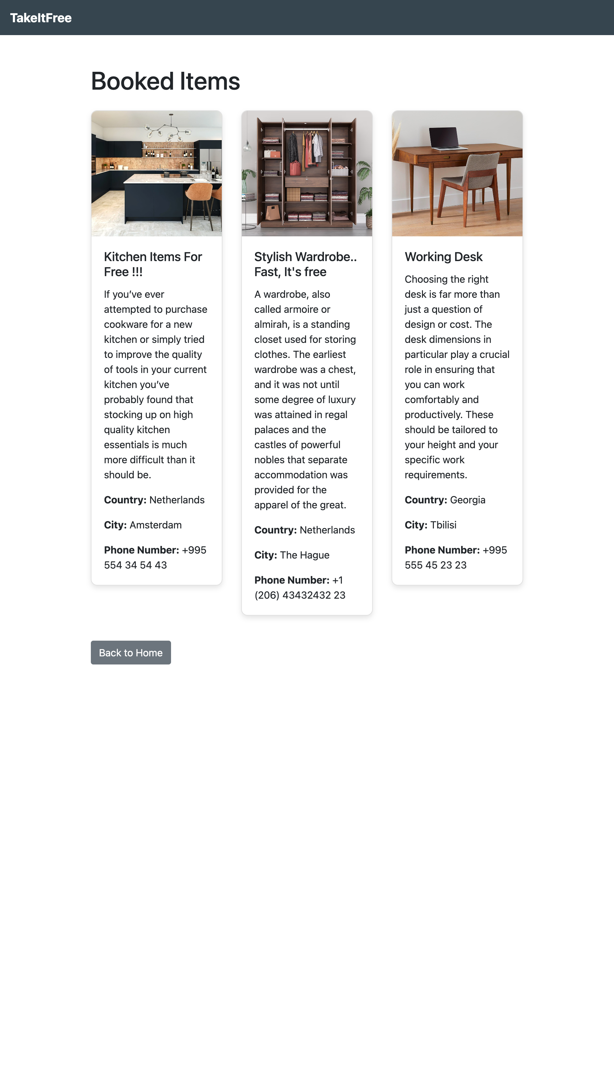
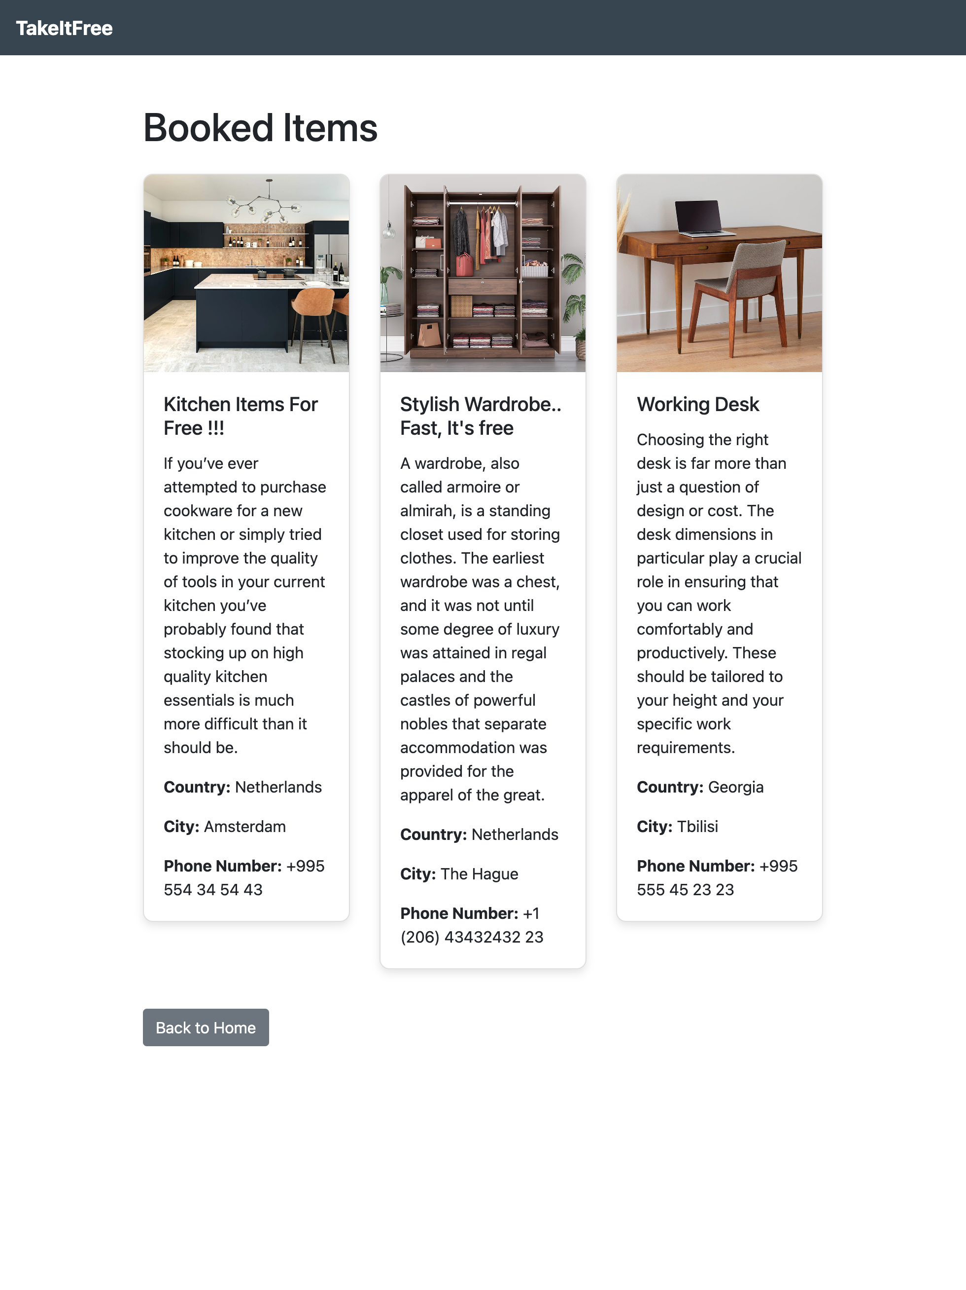
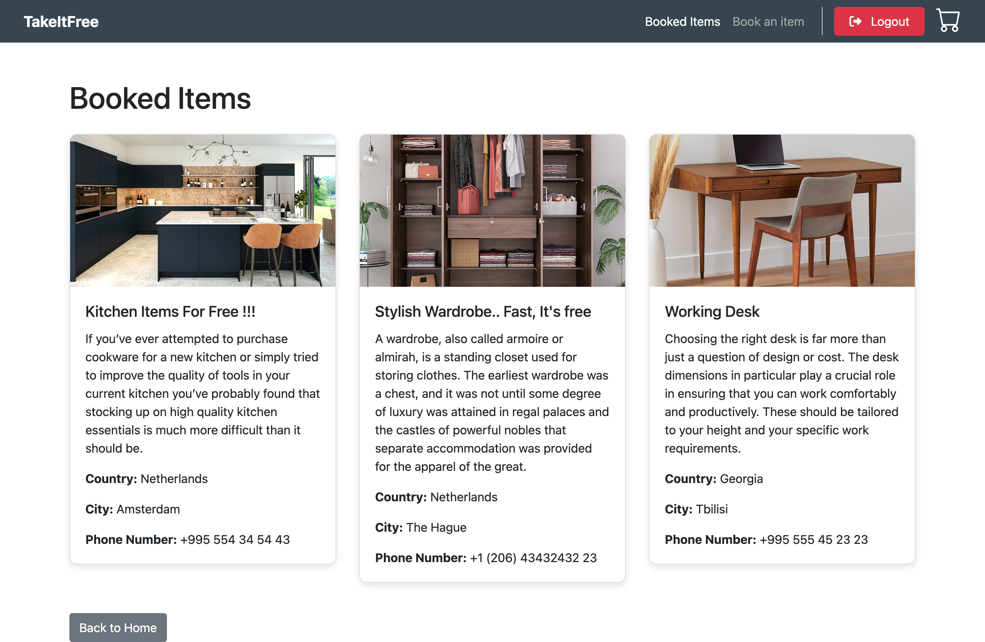
Capstone Project Interface Design
Compatible with Desktop, Tablet, Mobile Resolutions.

Slide 12
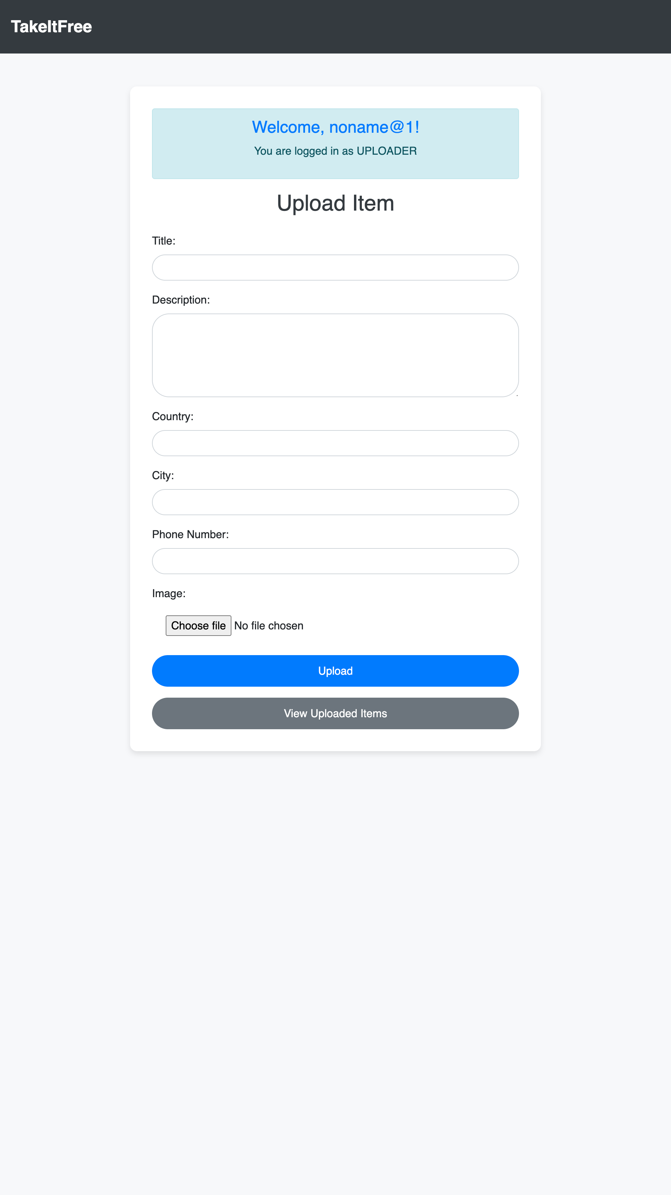
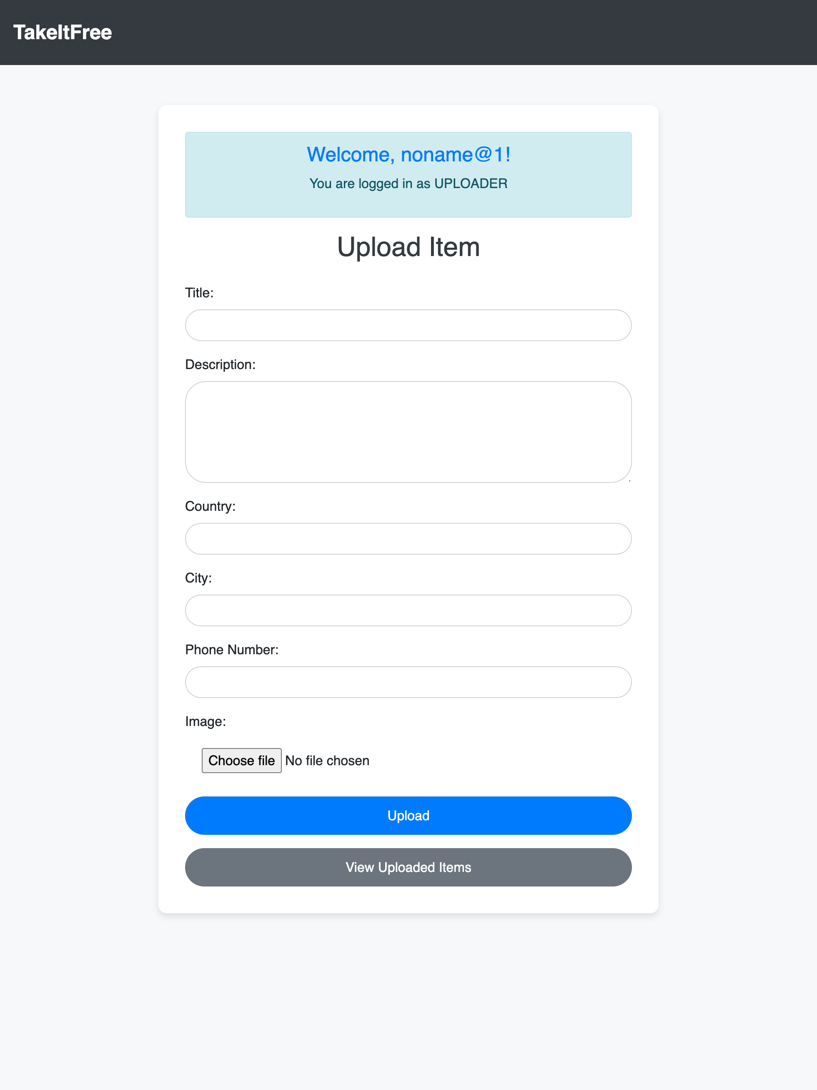
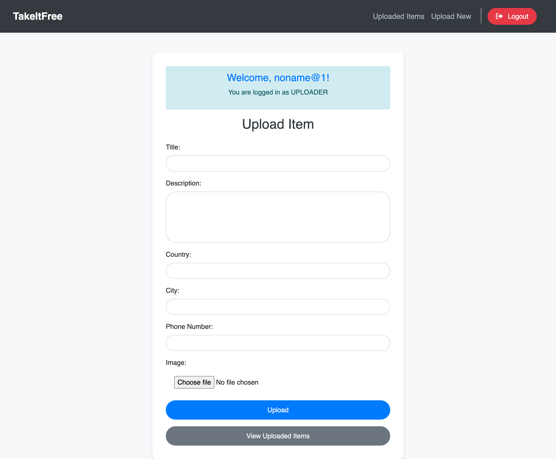
Capstone Project Interface Design
Compatible with Desktop, Tablet, Mobile Resolutions.

Slide 13

It should be possible to open it in any web browser without errors or overlaps and to complete both basic and advanced scenarios.
The prototype should reflect the actions and their results depending on the basic use case scenario.
Responsive, User-Friendly Design . (Compatible with Desktop, Tablet, Mobile Resolutions)

